Slide 1

PATH-AI-LOGY
HEALTHCARE USING AI
TEAM: QUADRA\CODE
OMKAR MANE | ADVAIT NAIK | ADITYA GURNANI | KRISH AMESUR

Slide 2
PROBLEM STATEMENT
The goal of this project is to create a system which can detect the presence of viruses and bacteria in the human body with the help of Deep learning model(CNN) created and trained solely for this purpose. The system is capable of identifying the chances of a patient containing a virus/bacteria by taking their chest X-ray as input and predicting the output using our model for the user input.

Slide 3
SOLUTION
PREDICTIVE ANALYSIS-
AI for pathology leverages the predictive analytics technology to assist clinicians to identify disease vulnerability prior to its onset.
Through intelligent machine learning, patients who are prone to a certain illness are flagged and therefore, capture the attention of the pathologist who can then advice long term care.
AI technology to gather digital pathology slides, analyze them and apply that knowledge to correctly identify and estimated infection.

Slide 4
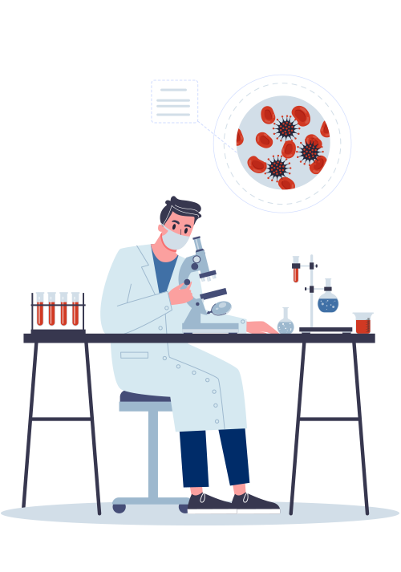
AI-ASSISTED DIAGONSIS
Our AI pathology software solution offers image analysis based diagnosis that is radically superior in accuracy through standardization and automation features that are enabled into our computational pathology technology.
DIMINISHES SUSCEPTIBILITY OF HUMAN ERROR
The automated function of computer-assisted diagnosis is poised to cause a disruptive transformation in the world of pathology.

Slide 5
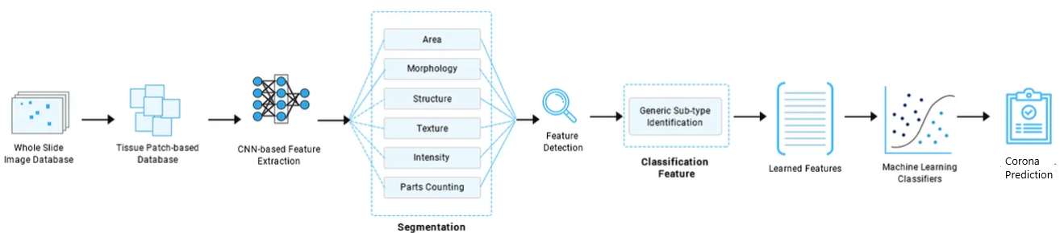
SYSTEM ARCHITECTURE
TECH STACK
Python | Tensorflow | Keras | Flask | HTML | CSS | JavaScript

Slide 6
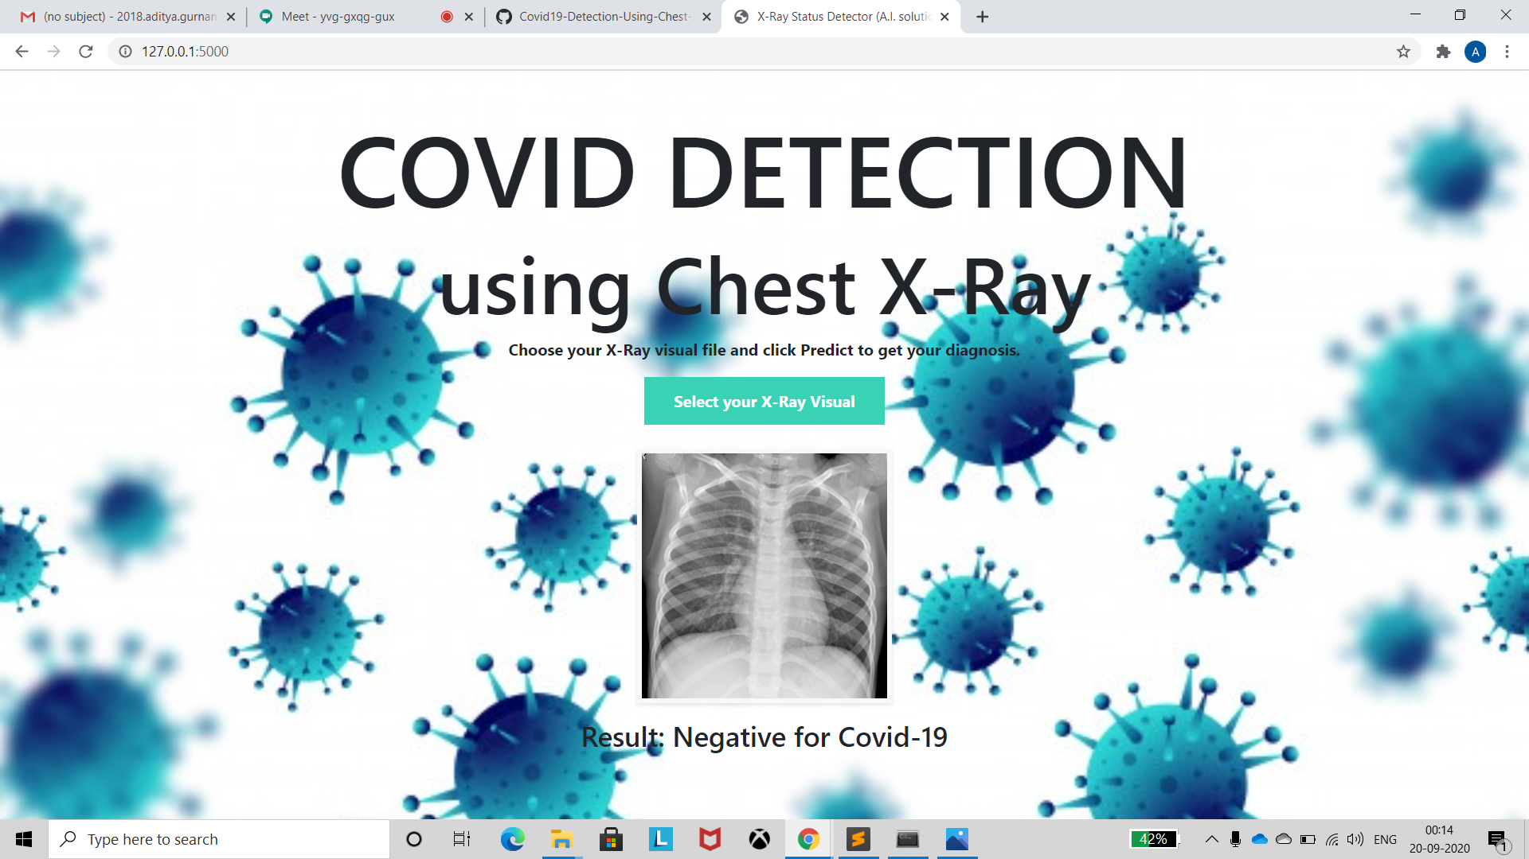
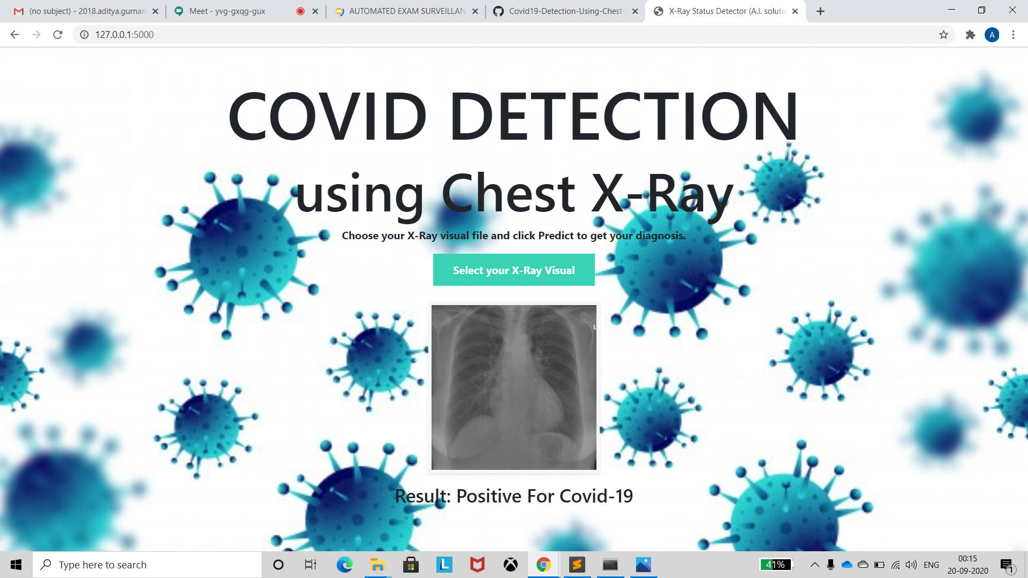
GitHub : https://github.com/AdvaitNaik/Hack_Chennai
⬅️ COVID NEGATIVE
COVID ➡️
POSITIVE

Slide 7
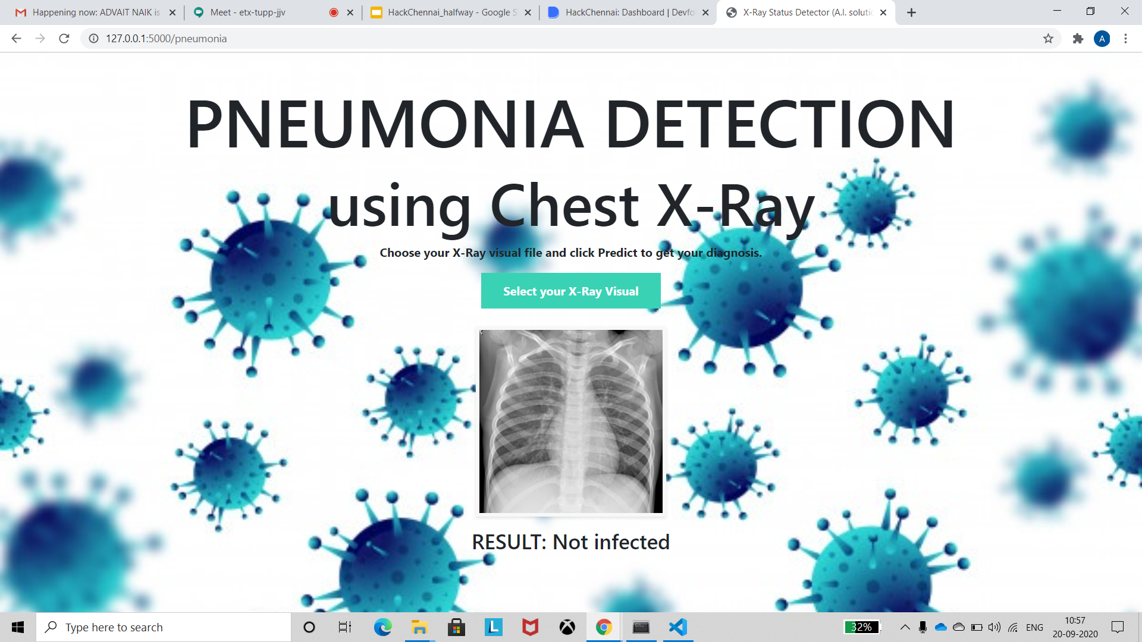

⬅️ NOT INFECTED
INFECTED➡️
THANK YOU!

